Slide 1
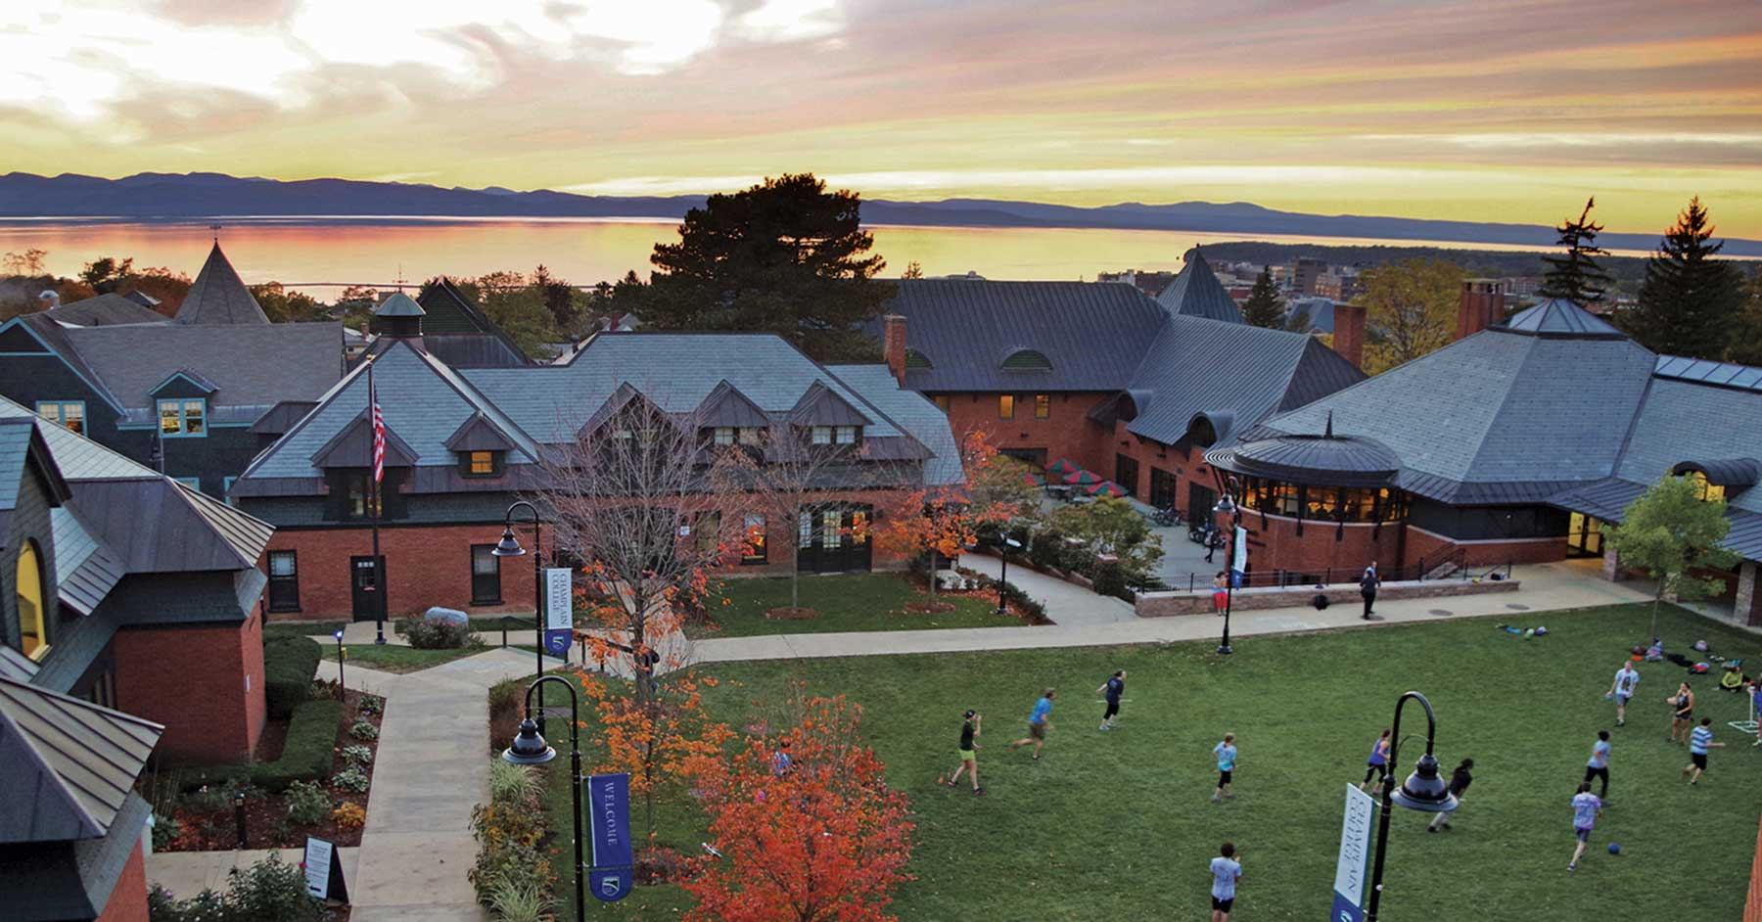
CCC-410: Capstone Project 2 Demo
By: Charlie Floquet

Slide 2





Project 2 Overview:
Obtain Raspberry Pi Camera, and capture base image set for atleast 10-15 different unique bricks to use for training.
Install software required for processing:
Python 3.6, Matplotlib, opencv (cv2), tqdm
Process hundreds (preferably thousands) of images into consistently colored and sized images, before saving them in a separate directory for use by the neural network.

Slide 3
Final Progress
Installing the software required for the image processing came with some hiccups, and I had to create a seperate conda environment that featured a more compatible Python 3.6 than the version I was using on the host. (Python 3.8.2)
In the end, I was able to successfully write a program capable of importing images from the host OS file system, resizing them to a more manageable size, and recoloring them to a grayscale before saving them externally in a seperate folder.

Slide 4
Goals/Objectives Not Met
Unfortunately, the PiCamera I purchased didn’t arrive until days before this was due, so while I started taking pictures of the pieces to categorize as soon as I got it, I had to use a public repository of Lego brick images, which isn’t a huge deal.
I will have no problem taking these images en masse over winter break, and will come back for second semester with a huge assortment of images (likely in the thousands or tens of thousands) to use for training.

Slide 5
Demonstration of Progress
Exit slide show, give demo on workstation

Slide 6
Adjustments to Project
Initially I wanted to use a cool sounding module called “pickle” to store the image data in a byte stream externally, but this proved to be weird and unnecessary within the scope of my own project.
I decided to use instead a system of folder hierarchies, where the unprocessed images are imported from the host OS/FS and resized/recolored before being exported/saved to a seperate file location to be used for training.

Slide 7
Link to GitHub, Resources Used
https://github.com/cfloquetcapstone/CCC-410-Capstone-Design/wiki
https://opencv-python-tutroals.readthedocs.io/en/latest/index.html
https://github.com/tqdm/tqdm

